Slide 1

Identification of Hotspot and Spatial Analysis for Particulate Matter and Gaseous Pollutants.
CE499 BTP Phase 2 Presentation
Gourav Dangi
190104035
Supervisor
Dr Sharad Gokhale

Slide 2
Introduction
An air pollution hotspot is a specific location with significantly higher levels of air pollution compared to the surrounding areas, often caused by human activities such as traffic or industrial emissions.
High levels of Pollutants and associated health risk are major concern for the government. The city management and people in-charge should be aware of the hotspot regions and the specific pollutants which are exceeding the limit so appropriate and effective measure can be taken.
This analysis provides an insight about the spread of pollutants across region and across time, which provides us the value of peak pollutants concentration and priority area with priority months for air quality management.
It will help authority to relocate people to safer zones is necessary

Slide 3
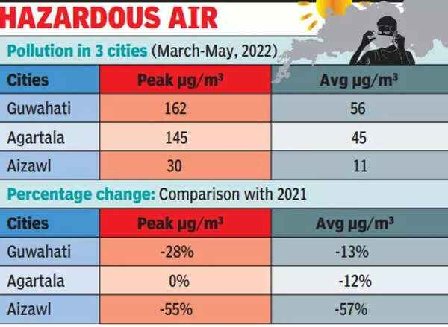
Significance of Study
Air quality have been worsening with time especially in Guwahati city with all the development going on.
High levels of Pollutants and associated health risk are major concern for the government. The city management and people in-charge should be aware of the hotspot regions and the specific pollutants which are exceeding the limit so appropriate and effective measure can be taken.
This analysis provides an insight about the spread of pollutants across region and across time, which provides us the value of peak pollutants concentration and priority area with priority months for air quality management.
It will help authority to relocate people to safer zones is necessary.
Most drastic change in pollution levels in north eastern cities

Slide 4
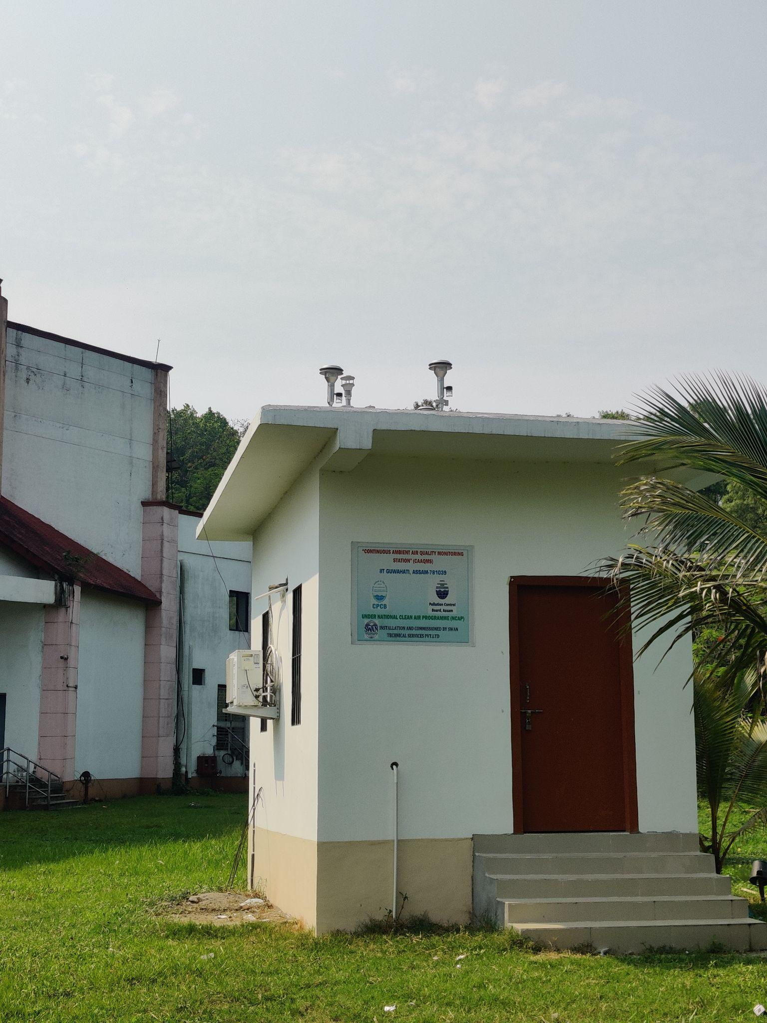
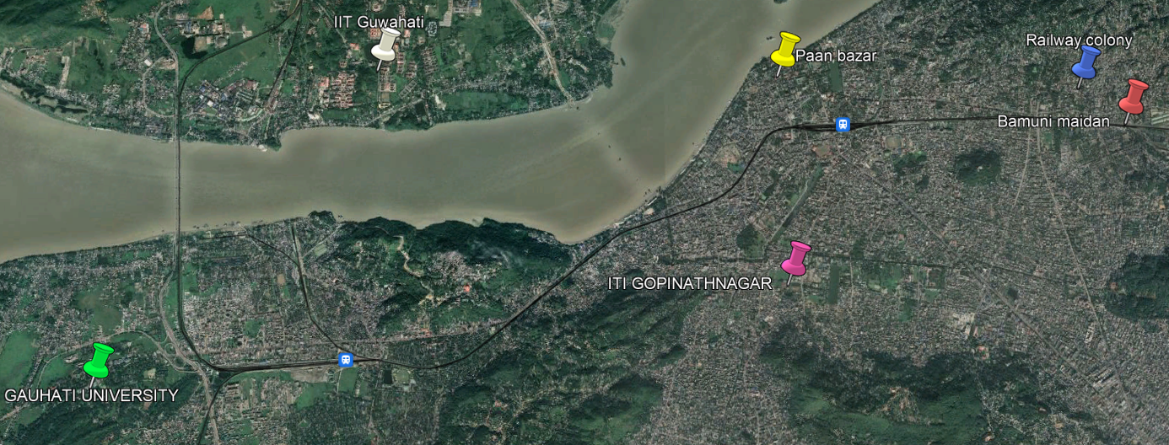
Study Area
The study area covers a total of 28 km long and 12 km wide rectangular area extending between north latitude of 26° 06’ 13.65’’ and 26° 12’ 44.62’’ and east longitude 91° 38’ 28.48’’ and 91° 50’ 40.59’’ forming a rectangular region. It includes a total of 6 monitoring stations of PCBA out of which 3 are continuous ambient air quality monitoring stations.
IITG CAAQMS

Slide 5
Data Collection
The three significant pollutants are recognized as NO2, SO2 and PM10.
The Concentration data of air pollutants namely NO2, SO2, and PM10 was collected for a duration of 1 year (January 1st, 2022 – December 31st, 2022).
The concentration values were found and plotted, and in some regions values of PM10 and NO₂ were exceeding the standard permissible limits.
Meteorological factors like temperature, wind speed, and wind direction may also have had a significant impact on the concentration of pollutants which were not considered here.

Slide 6
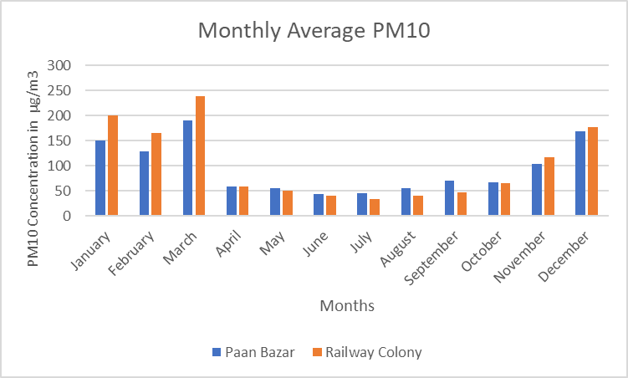
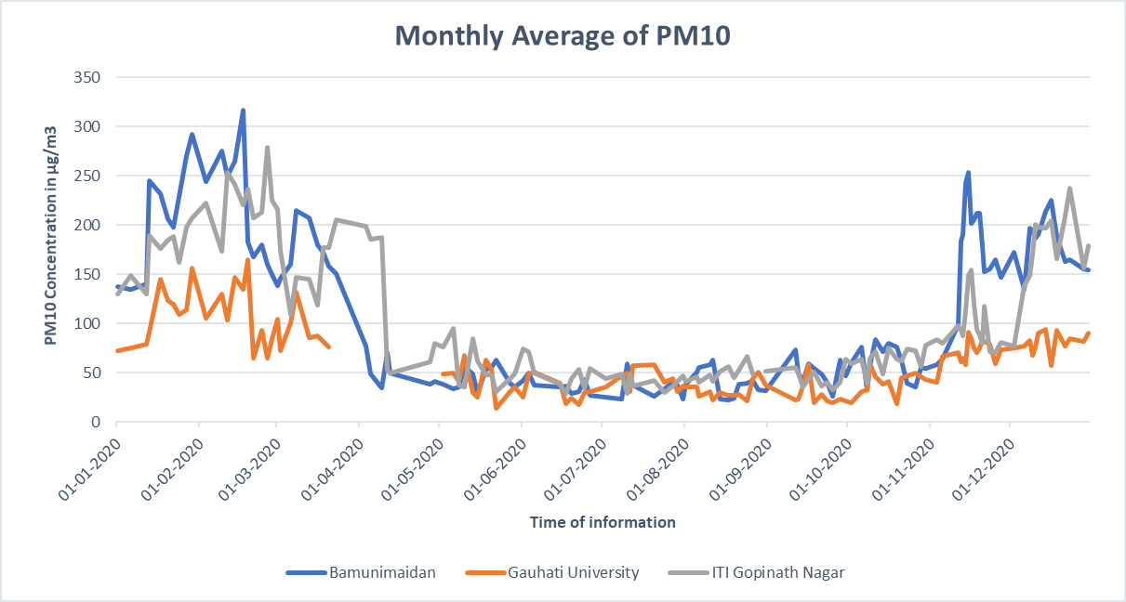
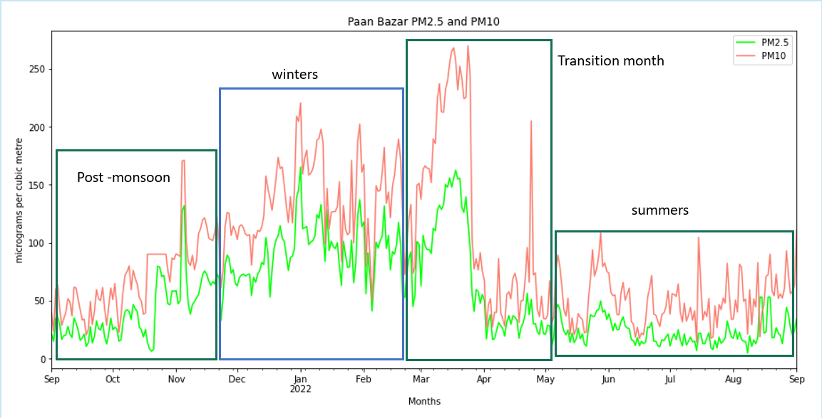
Data Interpretation
The months of October and April are transitional for changing air quality, and the concentration of pollutants was noticeably lower from April to October.
The concentration is well within the standard for summers. The variations observed were due to synergistic effects of localized sources, festivals, and unfavorable meteorological conditions. The AQI was high during these periods. Thus it can be inferred the data for monsoon-winters is suited for preventive measures as they represent the maxima of data.

Slide 7
Value prediction
The concentration was known sparsely however emission data was known for all blocks of grid.
Randomly 1 out of 6 monitoring stations (block in grid) was chosen and the BFS (breadth first search) model was run. This method closely resembles the Latin hypercube and random points were chosen.
Concentration and Emission are proportionate, so c1/e1 = c2/e2. Using this relation all unknown blocks of grids are predicted.
Starting points do affect the predicted value a little hence this operation was run 6 times (one for each monitoring station) and average values were taken.
Heat map was plotted after prediction of data and hotspots (The region in red) were identified.

Slide 8
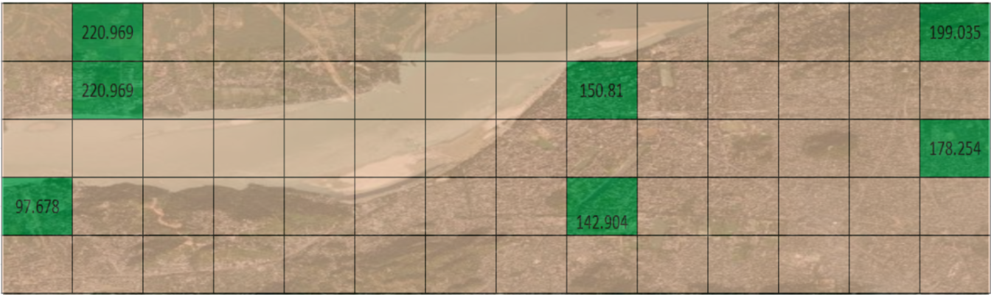
Value prediction
Study area with known concentration data of PM10 (in µg/m³) in green.
Remaining area Data to be predicted.

Slide 9
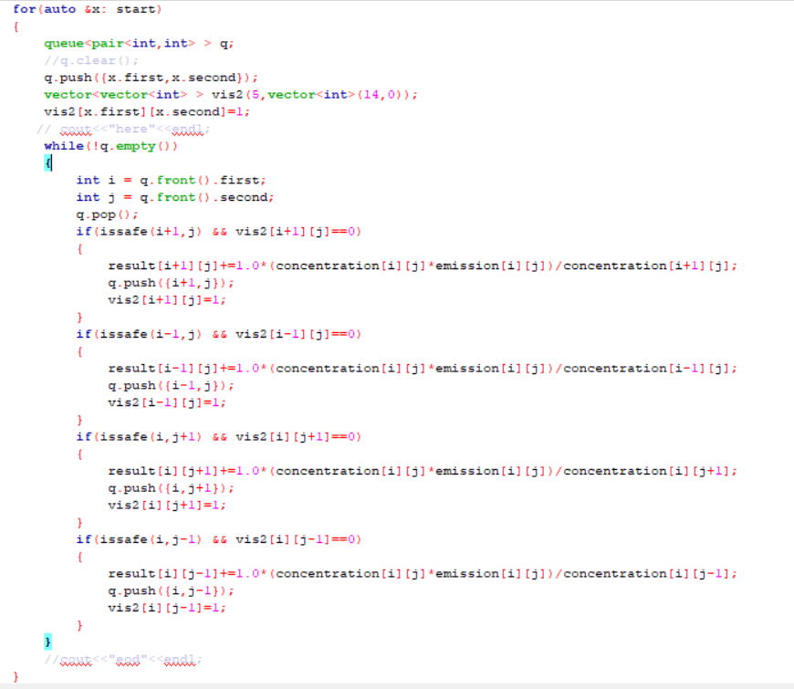
BFS
An iterative version of breadth first search was run which has a time complexity of O(N*M) where N and M are number of rows and columns respectively. This code will run perfectly for dataset range where NxM is <=100 a better implementation might run NxM <= 400. This code runs well within time limits, better algorithms need to be used if analysis needs to be performed on bigger partitions.

Slide 10
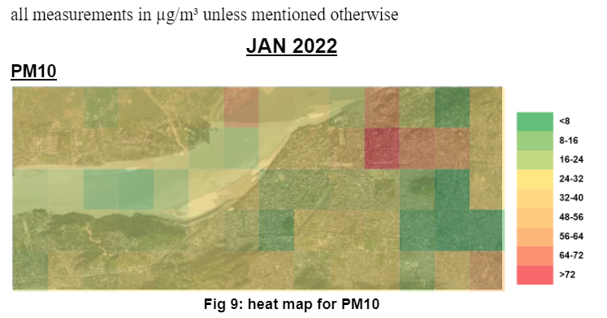
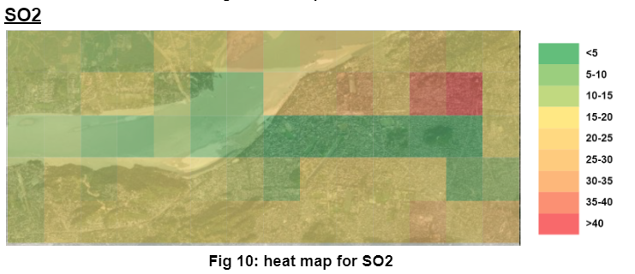
Sample Result
Pollution hotspots were identified as shown in figure by circle,
Here Railway colony and surrounding region are identified as hotspots.

Slide 11
Future Scope of Work
Concentration and emission data can be collected on a large scale to find the values more accurately and for smaller grid size.
Mathematical models can be implemented to cross validate our prediction like IDW (inverse distance weighting) or Kriging and use of techniques like KDE can improve predictions.
Since 2 more new CAAQMS stations have been installed (IIT Guwahati and LGBI airport) The quality of data is improving and after a significant amount of data is collected it can be incorporated in our study.
Grids can be refined and made smaller with proper emission data to carry further analysis.
Regions can be divided and studied individually, such as residential (Railway colony), Institutional (IIT Guwahati, Guwahati University, ITI Gopinath Nagar), Comercial/Tourist (Pan Bazaar).

Slide 12
Thank you

